Slide 1

M S D S 6 1 0 | F A L L 2 0 2 3
Hypothesis Testing
S A N G J U N | S H R E Y | B E L I N D A

Slide 2

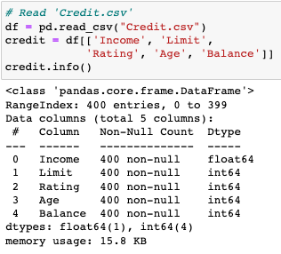
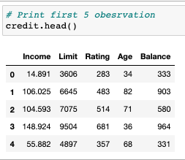
Pre-steps before running hypothesis testing
Import libraries
2. Read data
3. Check the data

Slide 3
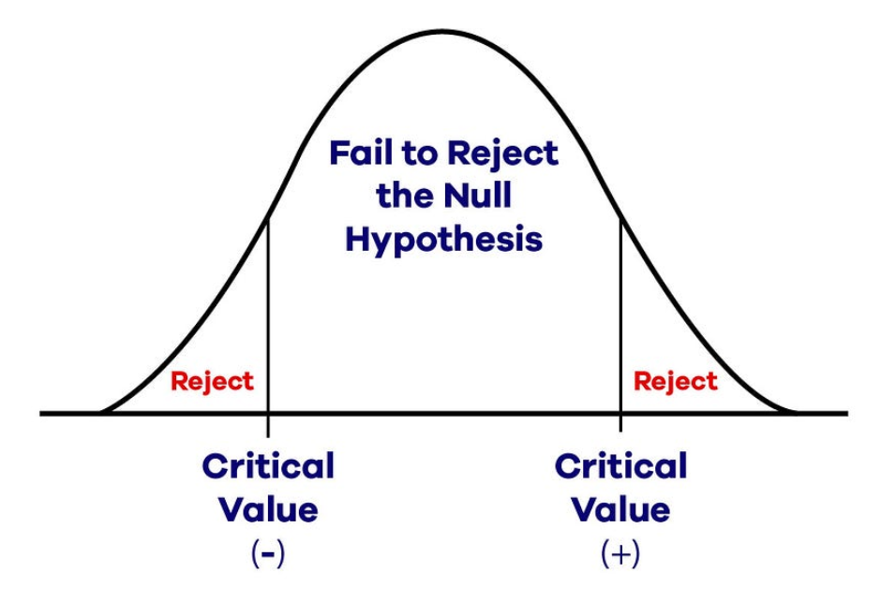
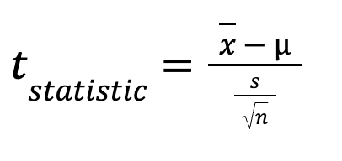
Basic steps of Hypothesis Testing
State the null hypothesis and the alternative hypothesis
Choose a statistical test
Perform the statistical test
Make a decision

Slide 4
Translating the model into Python syntax
Full model
Balance = ꞵ_{Income}x_{Income} + ꞵ_{Limit}x_{Limit} + ꞵ_{Rating}x_{Rating} + ꞵ_{Age}x_{Age}
Python syntax
model =smf.ols('Balance ~ Income + Limit + Rating + Age',data=credit).fit()
model.summary()

Slide 5
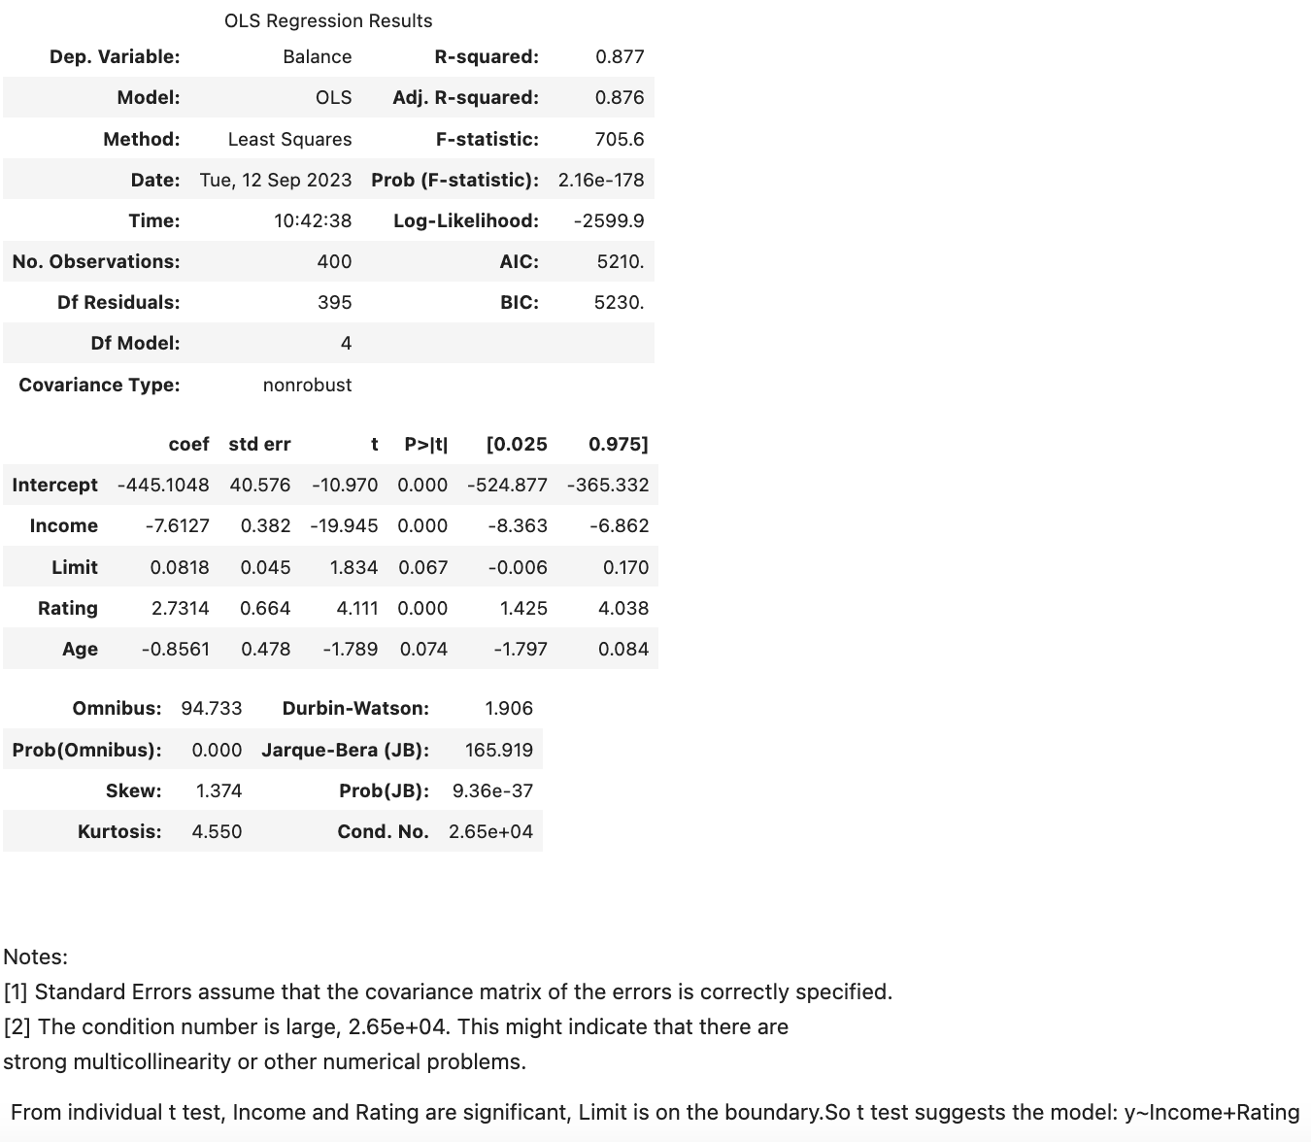
Output to interpret
For each of the features
H₀: ꞵ_{p} = 0
H_{a}: ꞵ_{p} ≠ 0
Accept null hypothesis at the 5% significance level
Reject null hypothesis at the 5% significance level

Slide 6
M S D S 6 1 0 | F A L L 2 0 2 3
Hypothesis Testing
S A N G J U N | S H R E Y | B E L I N D A

